Slide 1
NATURAL LANGUAGE PROCESSING (LECTURE 1)
Engr. Ahrar Bin Aslam
ahrarbaslam23@gmail.com

Slide 2
Introduction to Natural Language Processing:
Natural language processing (NLP) is a subfield of linguistics, computer science, information engineering, and artificial intelligence concerned with the interactions between computers and human (natural) languages, in particular how to program computers to process and analyze large amounts of natural language data.
Challenges in natural language processing frequently involve speech recognition, natural language understanding, and natural language generation.

Slide 3
When we say natural language, we mean human language as opposed to programming languages. Natural language refers to not only textual data, but also to speech and audio data.
Similarly, machines lacking natural language processing would be severely limited in their capabilities, restricted to working with numerical and visual data. They would struggle to achieve general artificial intelligence or exhibit human-like intelligence.

Slide 4
Without language, communication through text or speech would be impossible, leading to a significant loss of knowledge sharing and meaningful interaction. Reading books, listening to music would become challenging or even impossible.
Fortunately, machines can now finally process natural language data reasonably well. Let’s explore what commercial applications are possible because of this relatively newfound ability of computers to work with natural language data.
Machine translation
Speech Recognition
Question Answering
Text Summarization
Chatbots
Text-to-Speech, Speech-to-Text

Slide 5

Applications of NLP:
Machine Translation:
Machine translation is the process of using machines to translate from one language to another without any human intervention.
By far the most popular example of this is Google Translate, which supports over 100 languages and serves over 500 million people daily.
When it was first launched in 2006, the performance of Google Translate was notably worse than what it is today. Performance today is fast approaching human expert level.

Slide 6

Speech Recognition:
It may sound shocking, but voice recognition technology has been around for over 50 years. None of the voice recognition software had good performance or had gone mainstream until very recently, driven by the rise of deep learning.
Today, Amazon Alexa, Apple Siri, Google Assistant, Microsoft Cortana, digital voice assistants in your car, and other software are now able to recognize speech with such a high level of accuracy that the software is able to process the information in real time and answer in a mostly reasonable way.

Slide 7
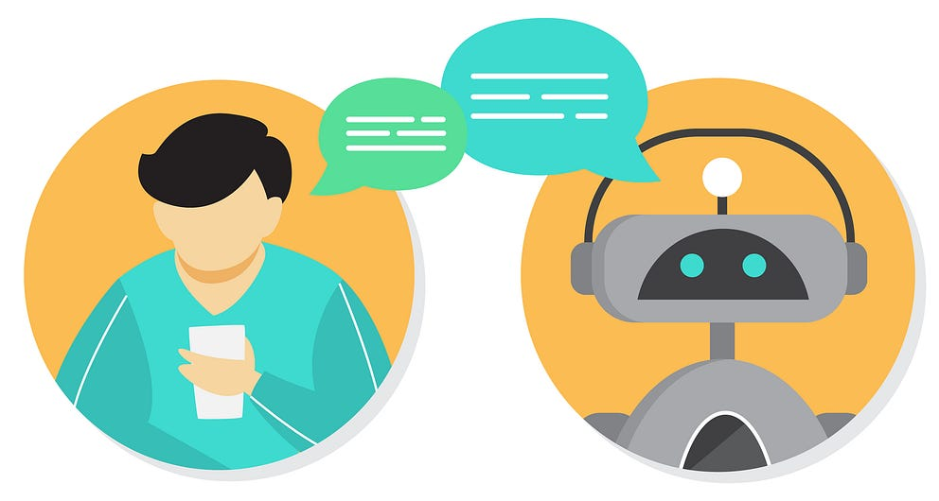
Question Answering:
For these digital assistants to deliver a delightful experience to humans asking questions, speech recognition is only the first half of the job.
The software needs to (a) recognize the speech and (b), given the speech recognized, retrieve an appropriate response. This second half is known as question answering (QA).

Slide 8
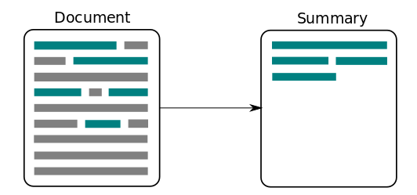
Text Summarization:
Text summarization is the process of condensing a longer piece of text, such as an article, document, or webpage, into a shorter version while preserving the essential information and meaning. It aims to provide a concise and coherent summary that captures the main points and key ideas of the original text.
It is helpful for students, researchers, and lots of office related workers.

Slide 9

Chatbots:
Chatbots are small pop-up boxes on websites that start conversations with users. They greet users, ask questions to understand their purpose, and provide assistance without human intervention.
They aim to automate customer engagement and offer instant help, making the user experience smoother and more convenient.

Slide 10
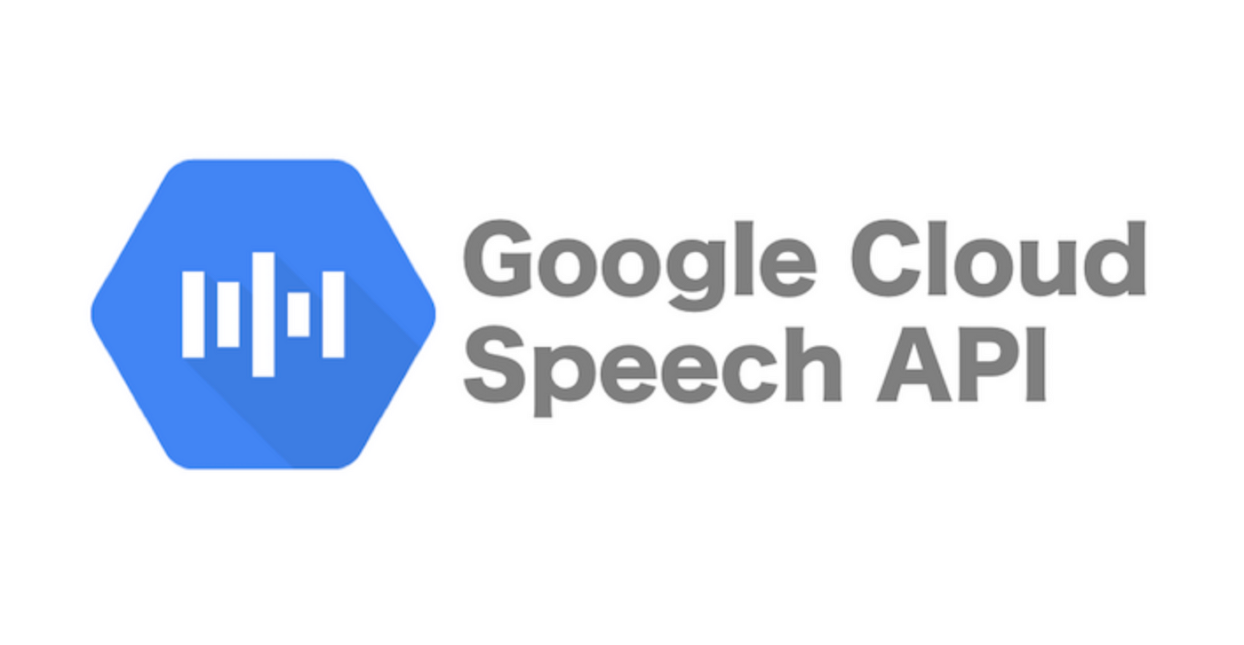
Text to Speech and Speech to Text:
Software is now able to convert text to high-fidelity audio very easily.
For example, Google Cloud Text-to-Speech is able to convert text into human-like speech in more than 180 voices across over 30 languages.
Likewise, Google Cloud Speech-to-Text is able to convert audio to text for over 120 languages, delivering a truly global offering.

Slide 11
Voicebots:
Ten years ago, automated voice agents on the phone were not very good.
They could only understand simple answers like "yes" or "no" and struggled with anything more complex. But now, companies like VOIQ have AI voicebots that are much better.
These voicebots can help businesses with sales, marketing, and customer success by making calls more efficient and automated. They can understand and respond to a wider range of questions and tasks, making them really helpful assistants for teams.

Slide 12
Text Generation:
Text generation involves the creation of written text by AI models. These models can generate human-like sentences, paragraphs, or entire articles based on given prompts or conditions.
Text generation can be used in various applications such as chatbots, content creation, language translation, and more. Advanced language models, like GPT-3, are capable of producing coherent and contextually relevant text across different domains and styles.

Slide 13
Audio Generation:
Audio generation, on the other hand, focuses on generating spoken content. AI models can convert text into synthesized speech, making it sound like a natural human voice.
This technology is commonly used in voice assistants, audiobook narration, language learning applications, and accessibility tools for visually impaired individuals. With the help of neural network-based techniques like text-to-speech (TTS) synthesis, AI systems can produce high-quality and expressive speech.

Slide 14
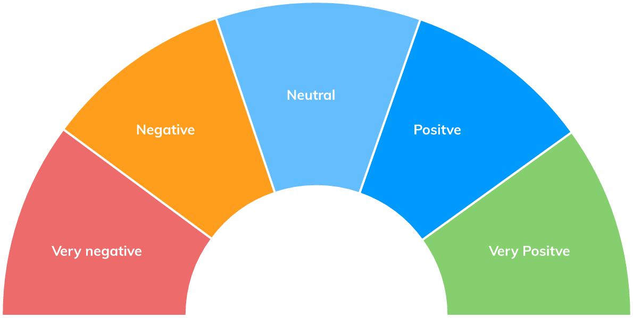
Sentiment Analysis:
With the explosion of social media content, there is an ever-growing need to automate customer sentiment analysis, dissecting tweets, posts, and comments for sentiment such as positive versus negative versus neutral or angry versus sad versus happy.

Slide 15
Syntax, Semantics, Pragmatics, and Discourse
Syntax:
Syntax: Syntax is like the rulebook for how words and phrases should be arranged to create sentences that make sense. It's all about following the right order and structure to form grammatically correct sentences.
Correct Syntax: "She sings beautifully." (Subject + Verb + Adverb)
Incorrect Syntax: "Sings she beautifully." (Verb + Subject + Adverb)
In the correct example, the sentence follows the syntactic rule of subject-verb-adverb order, while the incorrect example violates that rule.

Slide 16
Semantics:
Semantics is the study of meaning in language. It deals with the interpretation of words, phrases, and sentences and how they convey meaning.
Semantics looks at the relationship between words and the concepts or ideas they represent. It helps us understand how words combine to form meaningful sentences and how their meanings can vary in different contexts.
For instance, there's a world of difference in these two sentences: "I robbed a bank;" and, "A bank robbed me." In the former, I took money from a bank against their will. In the latter, they took money from me.

Slide 17
Pragmatics:
Pragmatics explores how language is used in real-life situations and how meaning is conveyed. It focuses on the speaker's intentions and the context of the communication. Pragmatics involves understanding meanings, speech acts, politeness, and the use of language to achieve specific goals in communication.
Example 1: "Could you please pass the salt?" Pragmatics: The speaker is making a polite request for the listener to pass the salt.
Example 2: "It's cold in here." Pragmatics: Depending on the context and tone of voice, this statement can be a request to adjust the temperature or simply an observation.

Slide 18
Discourse:
Discourse is about looking at the bigger picture of conversations or texts. It's like zooming out and seeing how different sentences and ideas connect to form a meaningful whole. It's about the flow of information, the organization of ideas, and how everything fits together to create a coherent conversation or piece of writing.
Example: A conversation between two friends:
Friend 1: "I'm thinking of going to the cinema this weekend."
Friend2: "That sounds like a great idea!

Slide 19

Libraries for Natural Language Processing:
NTLK
spaCy
NLTK: NLTK is a comprehensive library for NLP that provides a wide range of tools and resources for tasks such as tokenization, stemming, tagging, parsing, sentiment analysis, and more. It offers various corpora, lexical resources, and pre-trained models for language processing. NLTK is highly flexible and widely used in academia for research and education purposes.

Slide 20

spaCy:
spaCy is a modern and efficient NLP library designed for industrial-strength applications.
It focuses on providing fast and accurate NLP processing, with support for tasks like tokenization, named entity recognition (NER), part-of-speech (POS) tagging, dependency parsing, and more. spaCy is known for its speed and scalability, making it suitable for building large-scale NLP applications.

Slide 21
Both NLTK and spaCy have their strengths and use cases:
NLTK is more suitable for educational purposes, experimentation, and research, as it provides a rich set of tools, resources, and algorithms that allow for greater customization and exploration of NLP techniques.
spaCy, on the other hand, is well-suited for building production-level applications due to its speed and efficiency. It provides pre-trained models, linguistic annotations, and seamless integration with deep learning libraries like TensorFlow and PyTorch.

